Slide 1
Techie Talk: Form Development Panel

Slide 2

Panel of Experts!
Britta Scampton, Systems Administrator, TruNorth
Mitch Milam, Head Coach, xRM Coaches

Slide 3
Britta Scampton Systems Administrator, TruNorth
Power user with Dynamics CRM 2011.
Managing ongoing customization of two XRM implementations for Wealth Management firms.
About TruNorth
10 employees- Located in Minnesota and California
Concierge Wealth Management Firm that strives to fully utilize Dynamics CRM and integrated standard and industry specific systems for enhanced client communication, client service, and portfolio management through software enhanced processes and workflows.

Slide 4

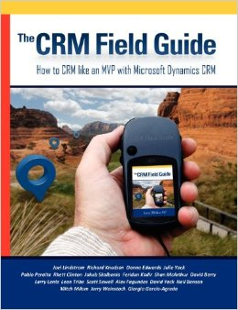
Mitch Milam Head Coach, xRM Coaches
Seven-time MVP for Dynamics CRM
Has worked with Dynamics CRM since 2005 (CRM 3.0)
Currently focuses on Dynamics CRM:
Architecture
Development
Developer and administrator training

Slide 5
Session Objectives
Interactive!
Share experiences developing Forms for Dynamics CRM
Discuss do’s, don’ts and best approaches
Answer YOUR questions

